Slide 1
Overview and Demo of CaIntegrator2
A Tool for Publishing and Analyzing Integrated Study Data

Slide 2
Agenda
Overview of caIntegrator2 capabilities
For this pre-alpha release
For production release
Release Plan
What you can do to prepare for using caIntegrator2

Slide 3
caIntegrator2 Goals
Have a single place where one can go to get all the information about a study
Clinical Data
Imaging Data
Genomic Data
Provide ways to browse and analyze the data
Explore and confirm hypotheses
Publish results and lists, e.g. of interesting genes
Have a way to roll out new studies easily
Have a consistent user experience across different studies
Lay the groundwork for cross-study comparisons

Slide 4


caIntegrator Examples
Rembrandt
A brain tumor study to host and integrate clinical and functional genomics data from clinical trials involving patients suffering from gliomas
CGEMS
A project to identify genetic alterations that make people susceptible to prostate and breast cancer
Others
I-SPY
caGWAS

Slide 5
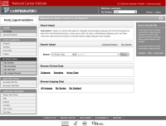


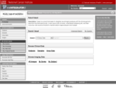





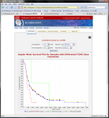
How caIntegrator2 works
Software Development Team
Project Team
Public
View Study
Array Data
caIntegrator2
Project Team
TBD (CTODS)
Deploy Study
Study Manager
Clinical Data
Images
Image Annotations
TBD (AIM/NCIA)
caIntegrator2
Tissue Data
caIntegrator
Array Data
Project Team
Public
Software Development Team
Project Team
Clinical Data
Rembrandt (for example)
Imaging Data
Process repeated for each project, reusing code and developer expertise

Slide 6
What caIntegrator2 can do now
Deploy studies
mRNA expression data from caArray
Imaging data from NCIA with image annotations from a CSV file
Clinical data from CSV files
Write complex queries
Join across clinical, microarray (mRNA expression) and image data
Publish queries to other users that return lists of interesting genes, subjects and/or images
Do analysis
Kaplan-Meier Survival Curves based on clinical or gene expression data
Export to GenePattern for more detailed analysis

Slide 7
What caIntegrator2 will do
More data types
Copy number
Genotype
Methylation
Timepoints
Clinical, array and imaging data can be associated with specific study timepoints (for instance, ‘Time of Diagnosis’ or ‘Six Months after Treatment Start’)
Queries will be able to operate on data from specific timepoints
More analysis
More seamless integration with GenePattern
Integration with other analysis tools such as geWorkbench
Allow updates of study data
New study subjects
Updated clinical, imaging and array data for existing subjects

Slide 8
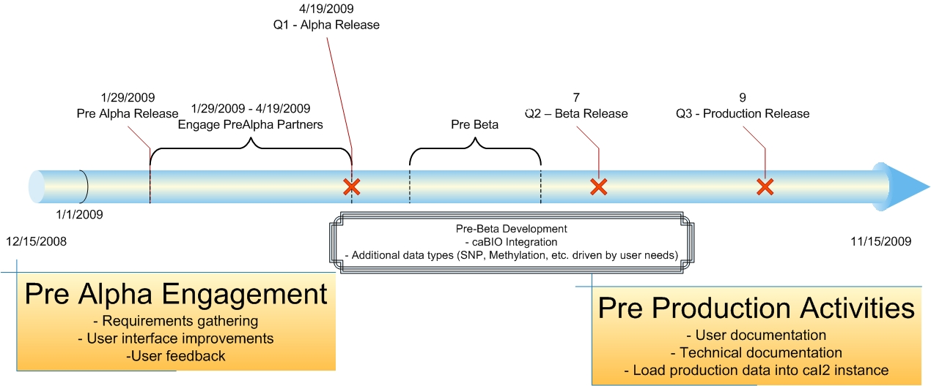
Release Schedule

Slide 9
What you can do to get ready
Have clinical data in CSV files
One line per patient
Your unique patient identifier in one column
Array data should be deposited in caArray, either locally or the CBIIT installation
Have CSV file with two columns, one the patient id and one the caArray sample id
Image data should be in NCIA as public data
Image annotation in CSV file
One line per image series
Unique image series id in one column
Have CSV file with two columns, one the image series id and one the patient id

Slide 10
Credits
caIntegrator2 Team
TJ Andrews
William FitzHugh
Michael Holck
Shine Jacob
Mark Lewis
JP Marple
Sangeetha Rajagopal
Matt Rehfuss
Eric Tavela
Leadership and Vision
Anand Basu
Subhashree Madhavan
NCIA & VASARI
Adam Flanders
John Freymann
Carl Jaffe
Daniel Rubin
caIntegrator Development Teams

